Slide 1
Simulation optimisation, variance reduciton, brilliance basics, FOM’s and tools
Peter Willendrup

Slide 2
Topics
Optimising your simulation (statistics etc.)
Variance reduction / biasing
Source brilliance and brilliance transfer
Deciding for a figure of merit
Tools: scans, iFit and guide_bot

Slide 3
Parallelisation for better stats, brute-force… Which hammer?
Use MPI parallelisation - included in macOS install from 2.4, easy to get on Linux…
Choice of compiler and optimisation flags can at times give ~a factor of 2 in speed, cf. clang vs. Intel C
Consider if McStas 3.0 and GPU’s could help you… (see Friday talk / demo)
- BUT: Always consider if you are asking the right question if runtimes reach days/weeks… Pick the right hammer!
+
Sledge-hammer / brute force!

Slide 4
Ensuring efficiency of the simulation is an important start…
Apply focusing techniques
At the source (spatially, temporally, in wavelength…)
At the sample, if possible
(carefully!) Apply SPLIT - but only if “immediately” followed by Monte Carlo choices, e.g. in sample
Alternatively use MCPL o/i which allows repetition - beware of biases! Same rule of thumb in order here.

Slide 5
Ensuring efficiency of the simulation is an important start…
Apply focusing techniques
At the source (spatially, temporally, in wavelength…)
At the sample, if possible
(carefully!) Apply SPLIT - but only if “immediately” followed by Monte Carlo choices, e.g. in sample
Alternatively use MCPL o/i which allows repetition - beware of biases! Same rule of thumb in order here.
“Repeat the good neutrons that made it here…” - More on Thursday.
I/O mechanism for event files, package independent - More at the end of this section
All of this can be considered “variance reduction”
or biasing

Slide 6
Important points to remember
Your simulation will only contain elements you provided / defined
… to the precision you defined
Answers the questions you posed
Background essentially only from “sample”, or sample-near objects
Use concentric geometry / Union concept for sample env
Source-term backgrounds are usually an MCNP-oriented problem (http://coimbra2016.essworkshop.org, http://istsi.essworkshop.org, https://github.com/McStasMcXtrace/SINE2020WP8)

Slide 7
What to optimise? Figure of merit requires thought…
Also, a case-specific FOM should be chosen
Usually not a matter of simply maximising SP flux…
Depends strongly on the science to be done
Typical sample size, needed q and E resolution etc.
Relevant wavelength-band, needed dynamical range, needed resolution
Cost (e.g. in the form of shielding requirements, guide coatings)
But brilliance-transfer is probably a good quantity to think of…

Slide 8
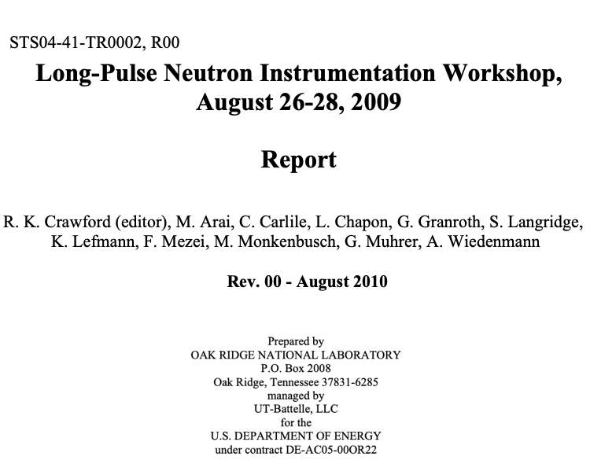
FOM examples for different types of instruments
Crawford, R. K., Arai, M., Carlile, C., Chapon, L., Granroth, G., Langridge, S., ... Wiedenmann, A. (2009, Aug 26). Long-Pulse Neutron Instrumentation Workshop, August 26-28, 2009. (Oak Ridge National Laboratory ed.) Oak Ridge, USA.

Slide 9
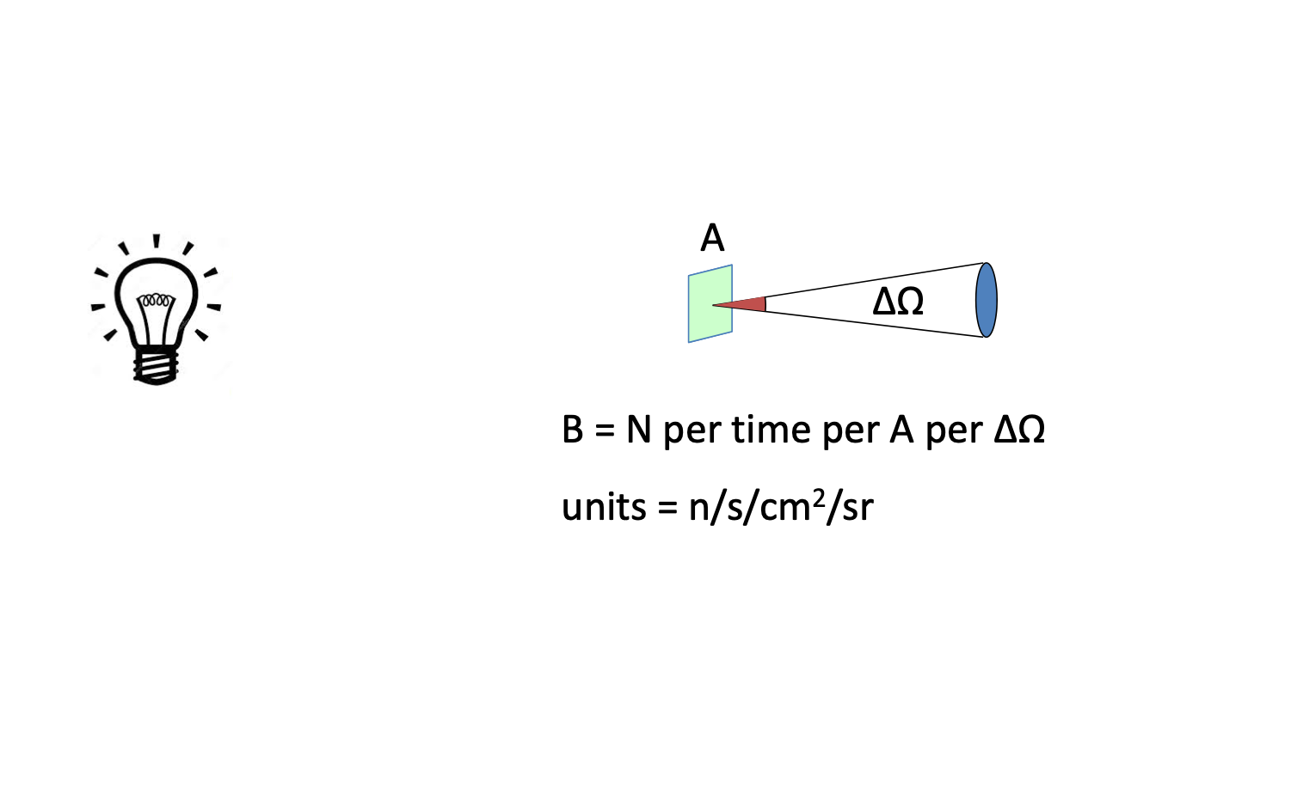
Neutron flux - and brilliance / brightness

Slide 10
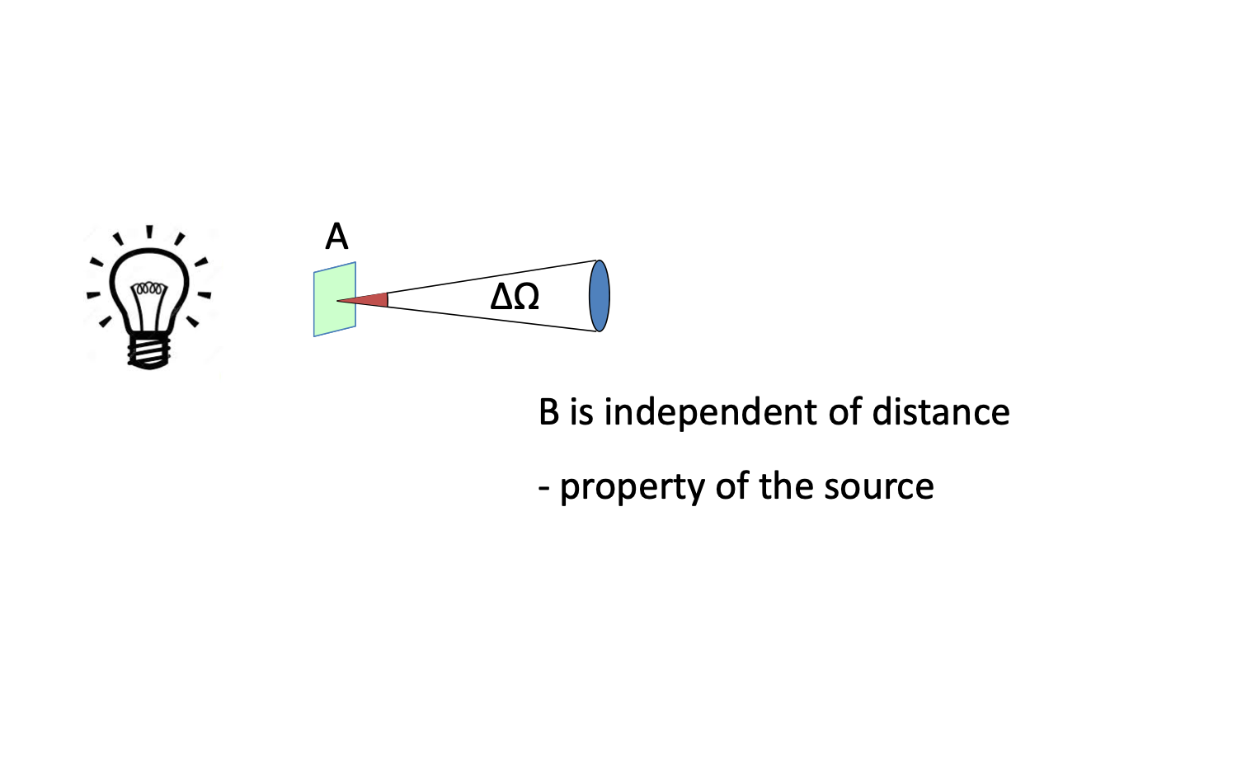
Neutron flux - and brilliance / brightness

Slide 11
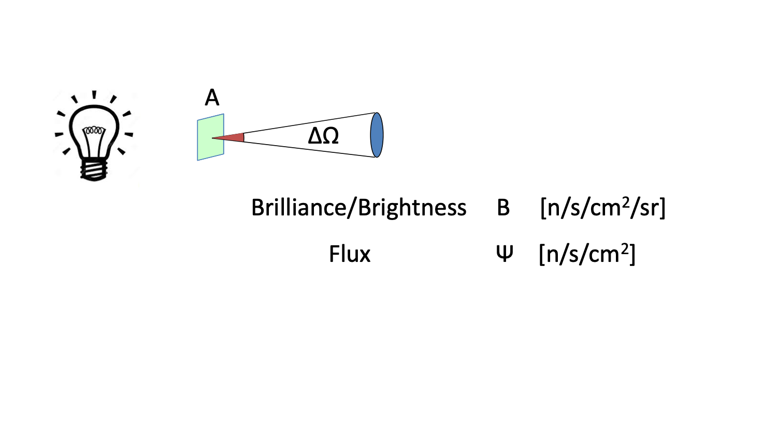
Neutron flux - and brilliance / brightness

Slide 12
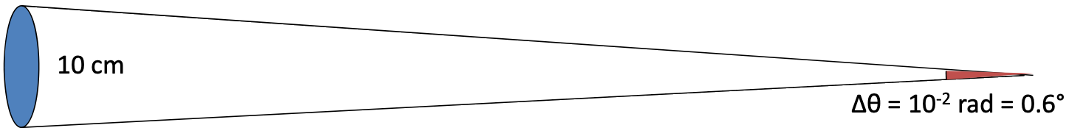
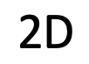
Neutron flux - and brilliance / brightness
10 m

Slide 13
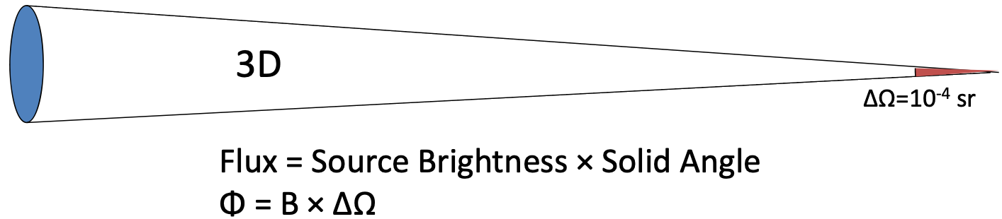
Neutron flux - and brilliance / brightness
10 m

Slide 14
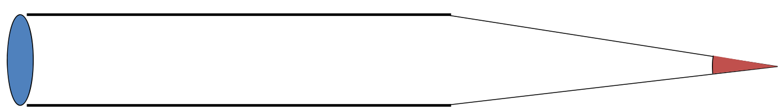
Neutron flux - and brilliance / brightness
10 m

Slide 15
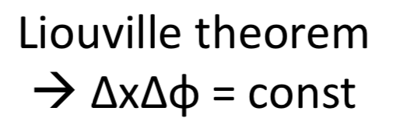
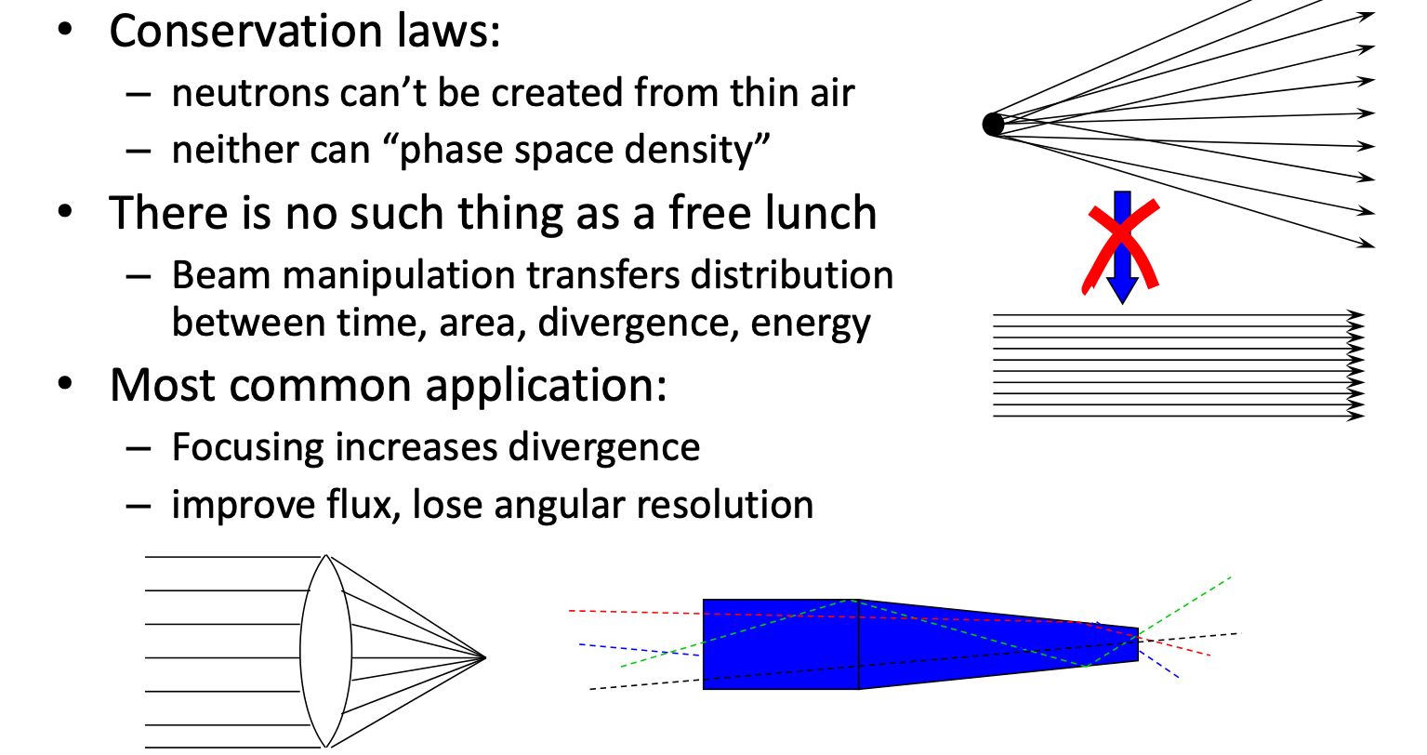
Liouvilles Theorem

Slide 16
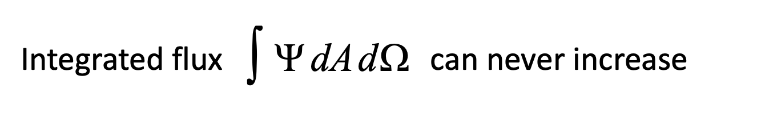
Liouvilles Theorem
12

Slide 17
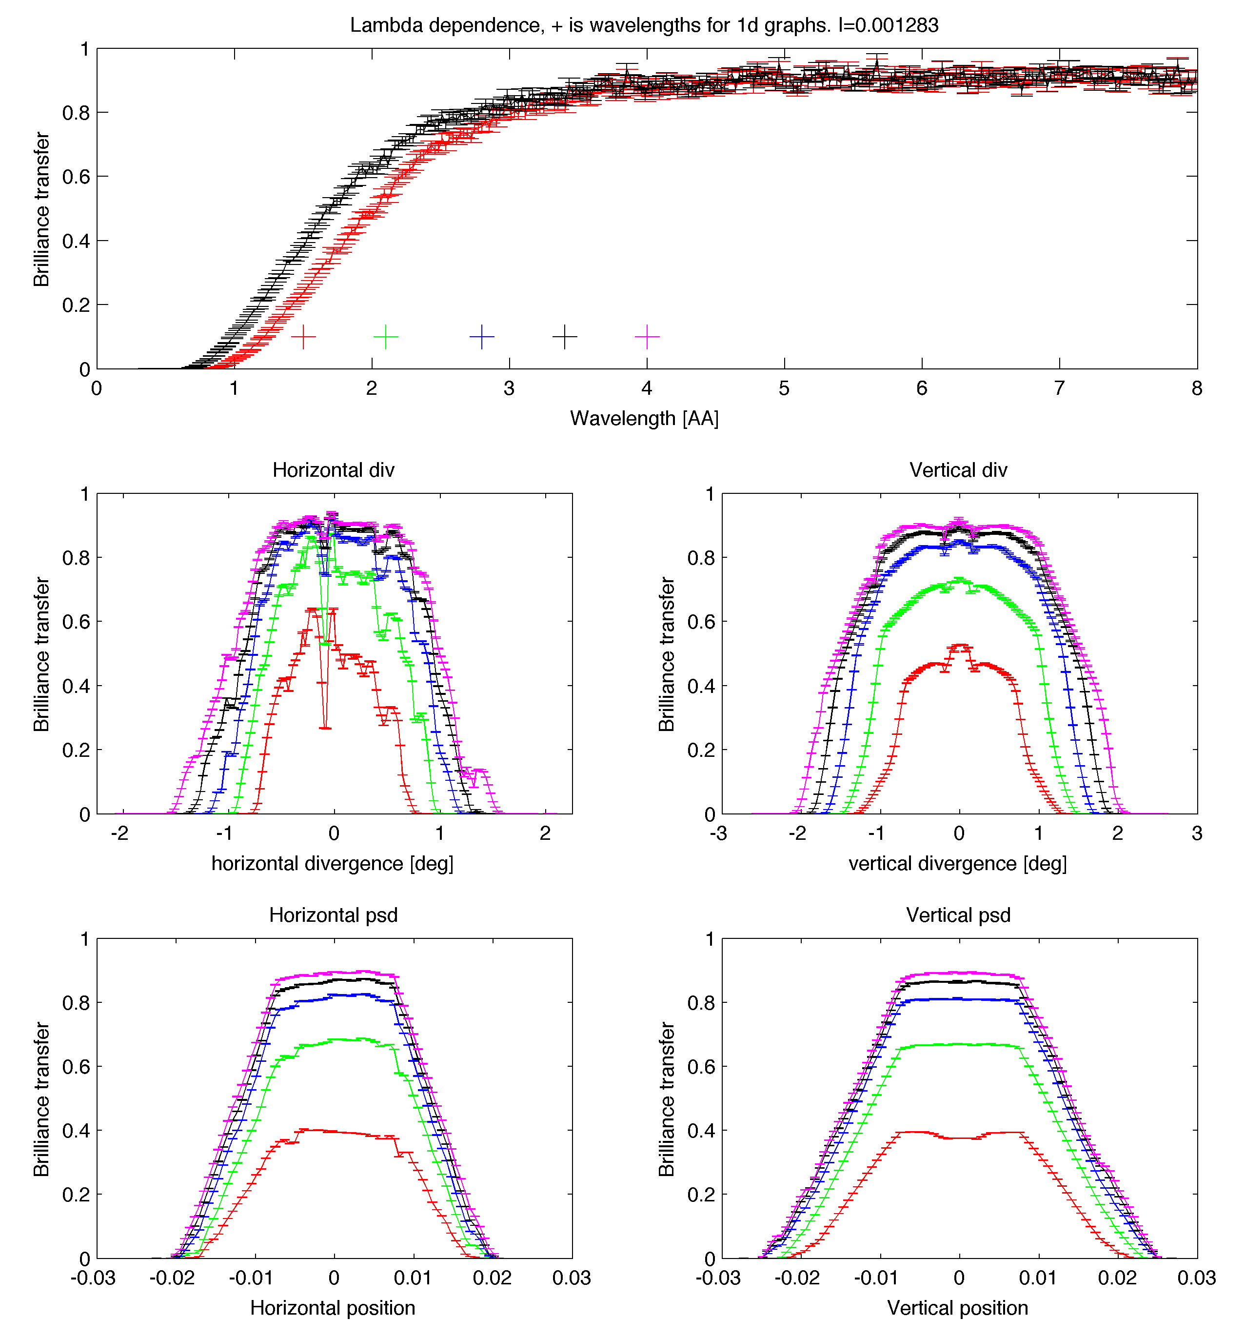
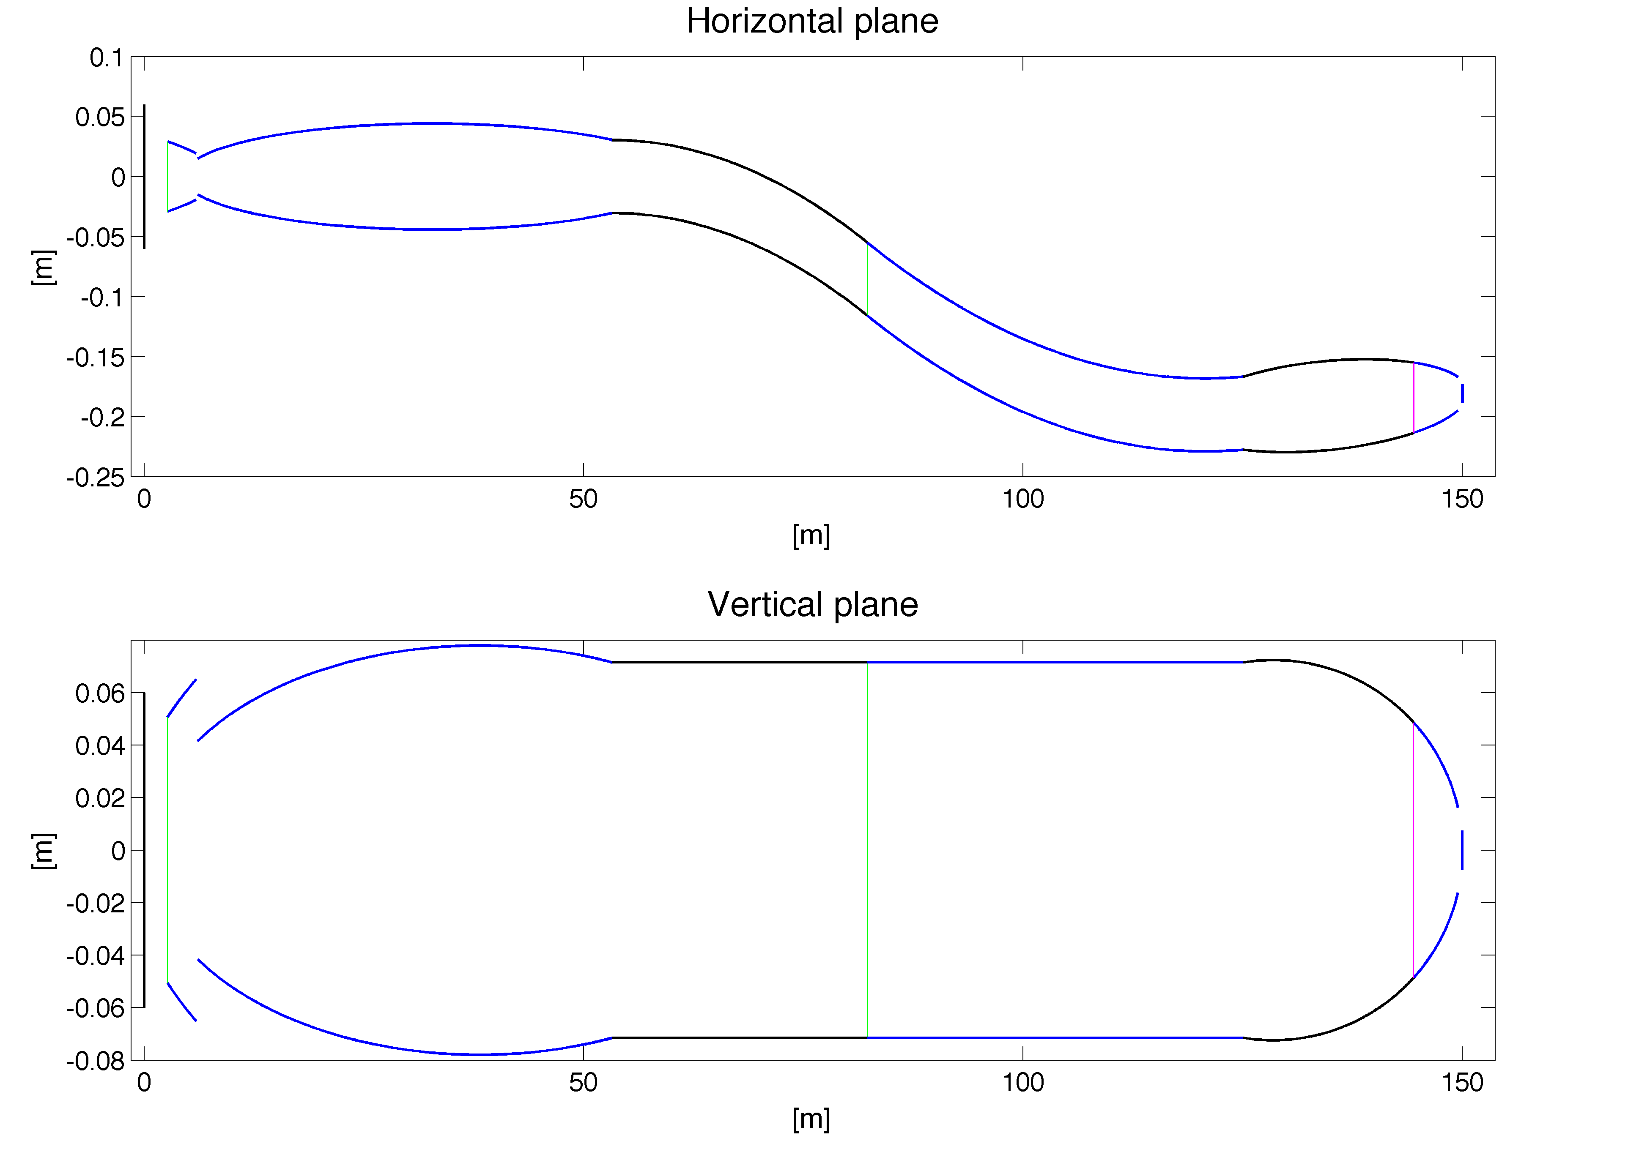
A good optic maximises transfer of brilliance
Example, elliptic guide designed by guide_bot See Thursday talk by Mads Bertelsen

Slide 18
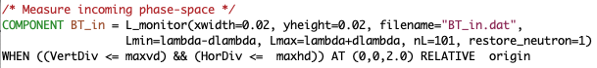
Simple BT-means by McStas-code? See example folder…
BTsimple, measures phase space before optic…
1.

Slide 19
Simple BT-means by McStas-code? See example folder…
Spatial ranges
BTsimple, measures phase space before optic…
1.
Spectral range
Directional range

Slide 20
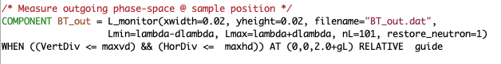
Simple BT-means by McStas-code? See example folder…
BTsimple, measures phase space before and after optic…
1.
Same phase-space element and identical binning…
2.

Slide 21
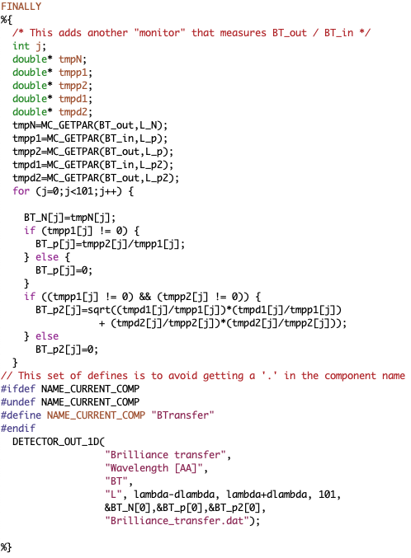
Simple BT-means by McStas-code? See example folder…
BTsimple, measures phase space before and after optic, calculates transferred fraction as fct. of wavelength:
Performs piece-wise division of the bins w. error propagation
3.
1.
2.

Slide 22
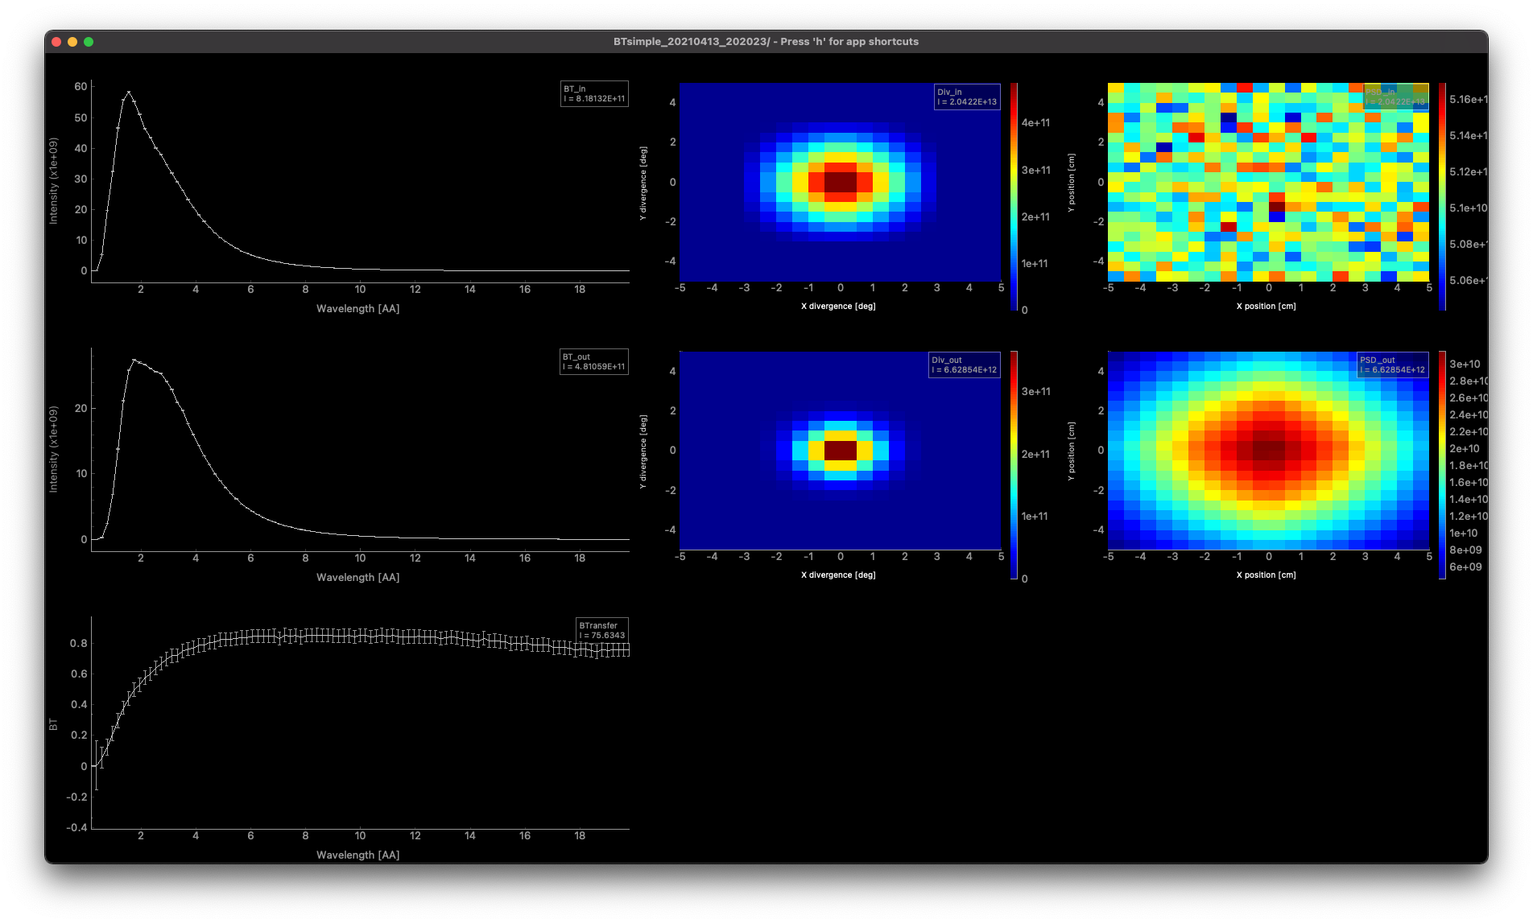
1
BTsimple example output
2
3

Slide 23
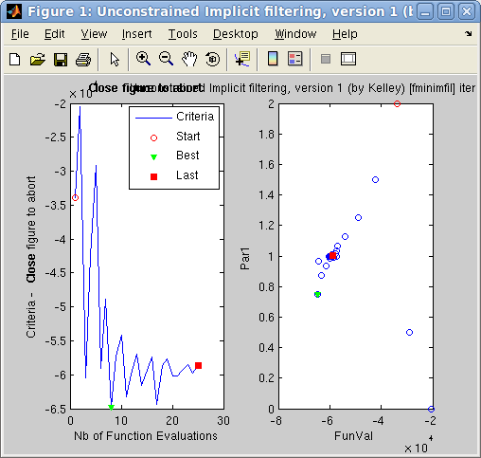

Optimisation tools…
mcrun and mcgui provide
Simple equidistant line-scans or colinear scans par=a,b -N k. / par1=a,b par2=c,d -Nk
mcrun further provides
-L list mode (can be non-equidistant, user chooses order, still a form of scan) par1=a,b,c,d,e,f par2=g,h,i,j,k,l
Run your simulations via iFit http://ifit.mccode.org - see http://ifit.mccode.org/McStas.html
McStas simulation becomes an object function, monitor(s) an optimisation criterion
Includes a host of different optimisers, e.g. particle swarms in parameter-space
Matlab-based, perform calculations based on monitor outputs (!! use Matlab <= 2017b !!)
Can work as a recompiled binary, but not as stable as a pure Matlab
Use official distribution package from http://ifit.mccode.org/Downloads/iFit.zip, GitHub code is too ‘bleeding edge’ guide_bot tool is built on iFit, see Thursday talk. Mads recommends Matlab 2012 and iFit 1.3…

Slide 24
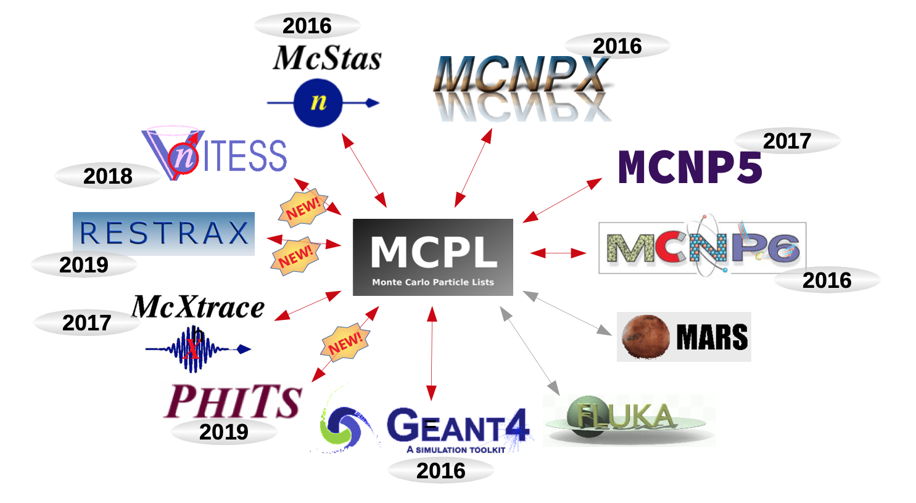
Connectivity with other codes… Esben?

Slide 25
By now you have been presented with most of the bricks…
Next, think of how to assemble them to solve your specific problem…

